Slide 1


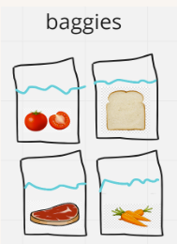
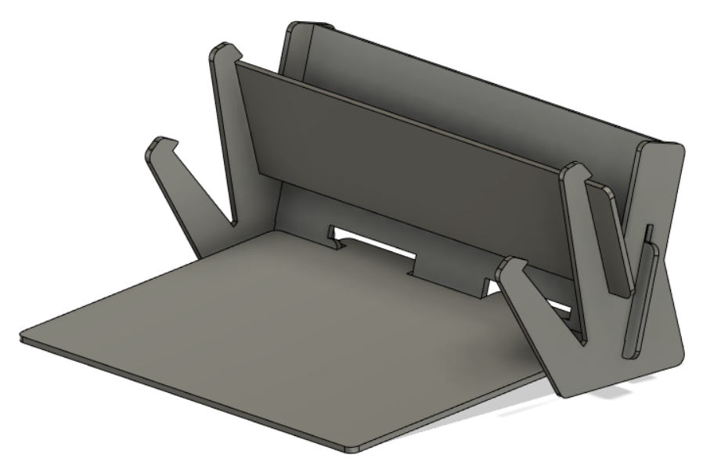
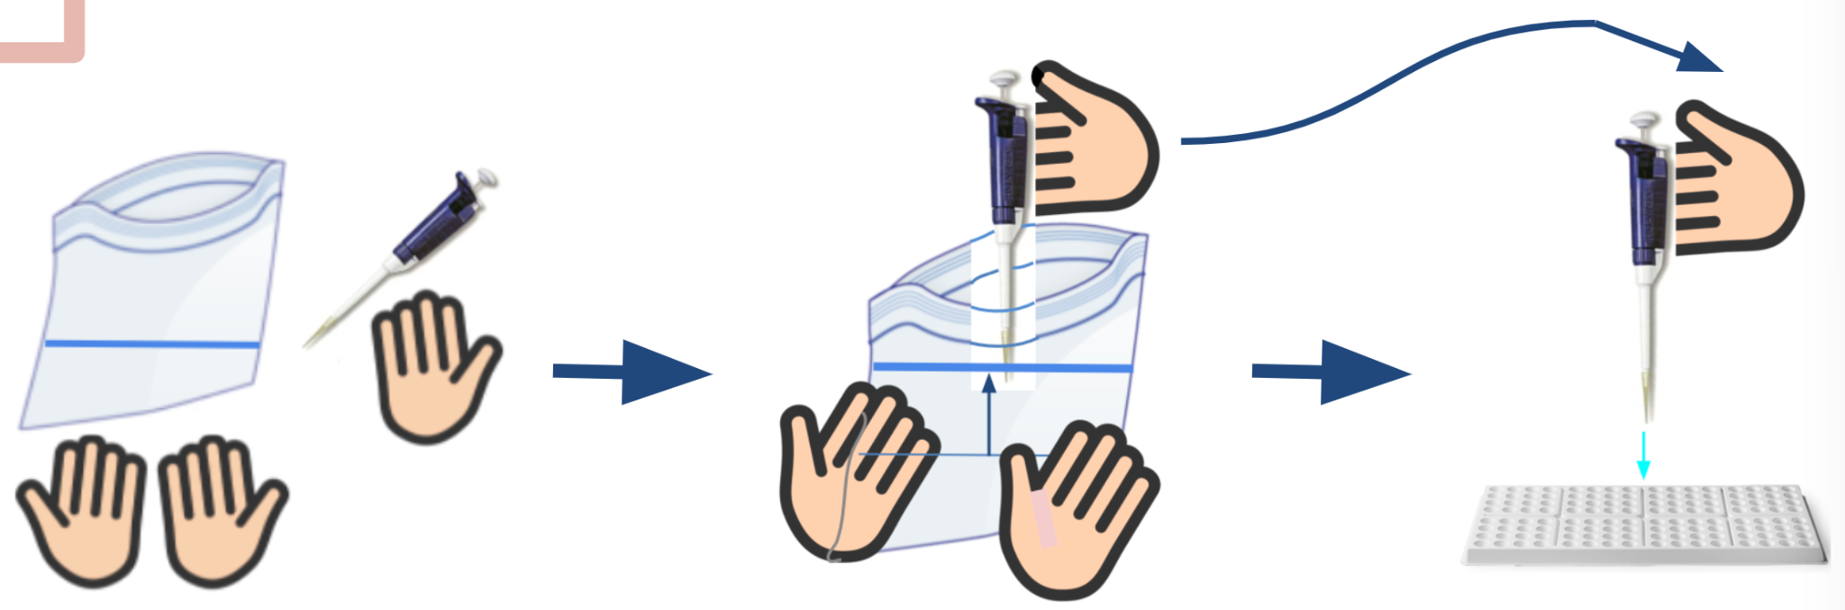
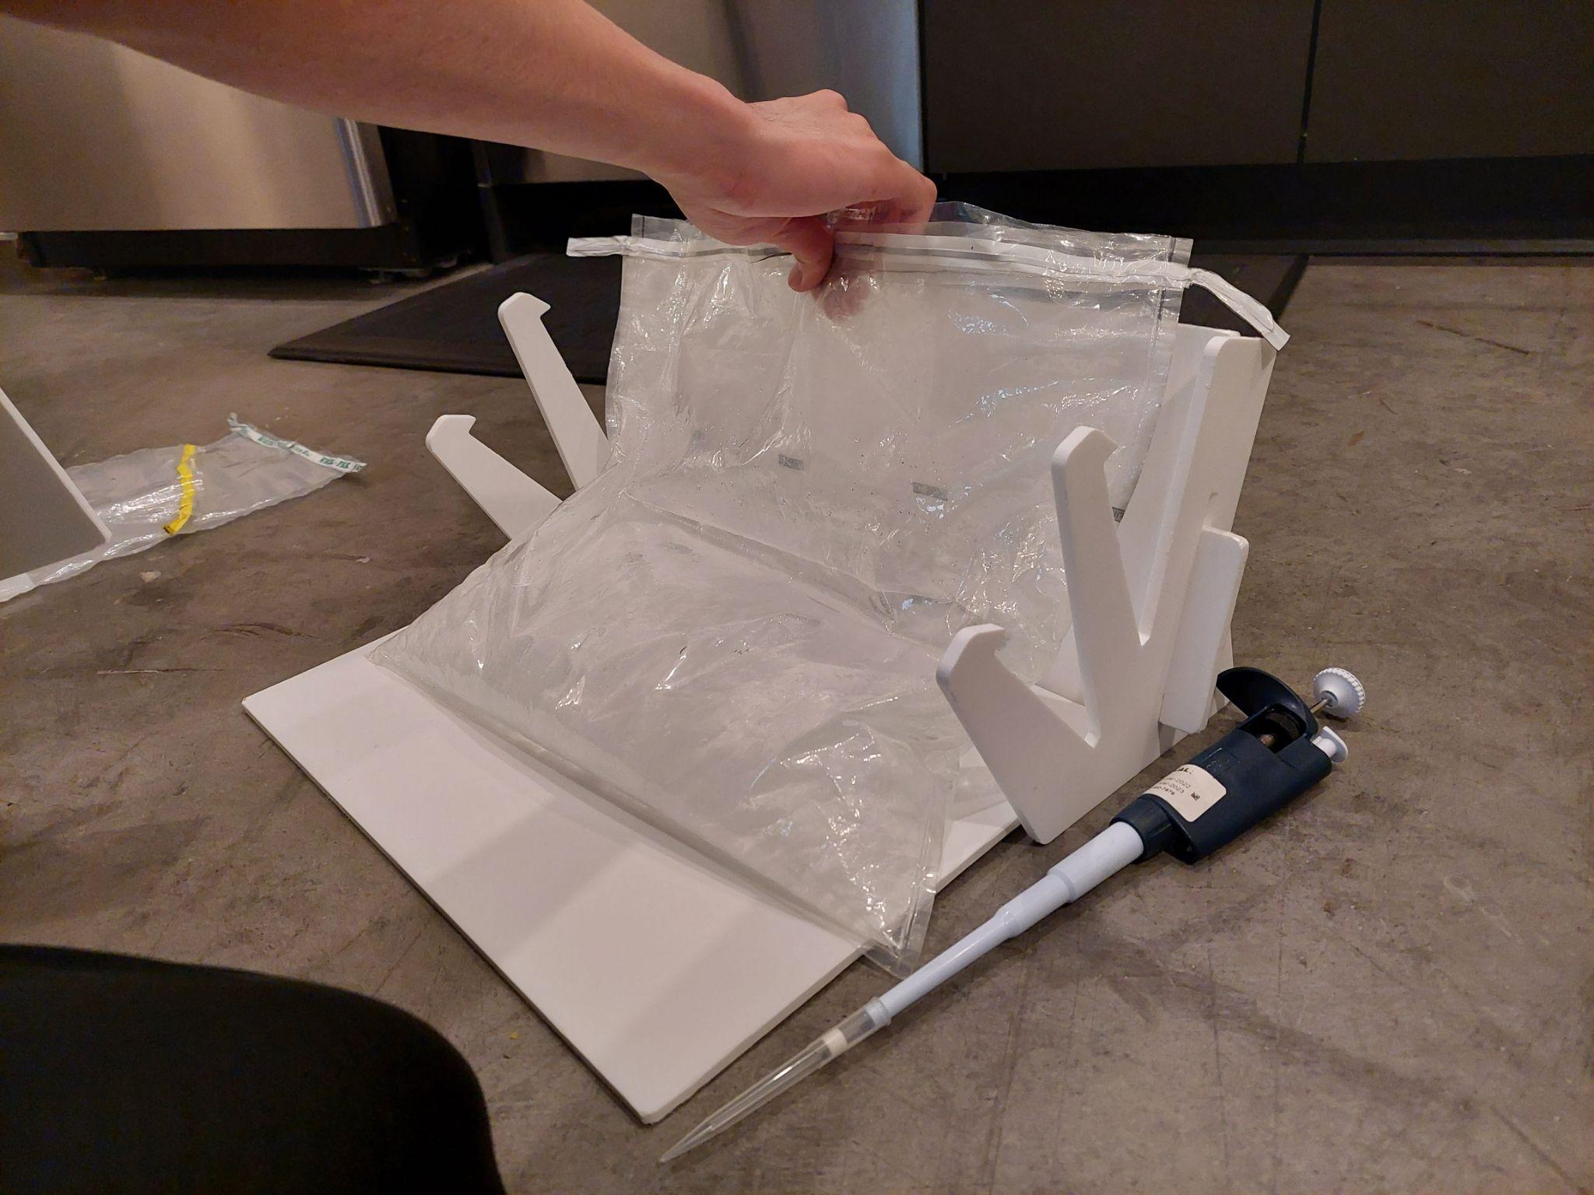
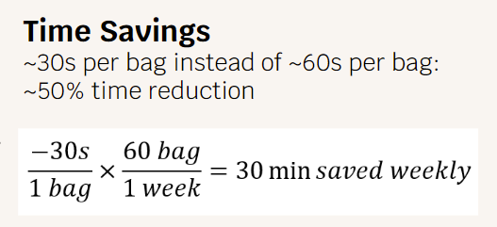
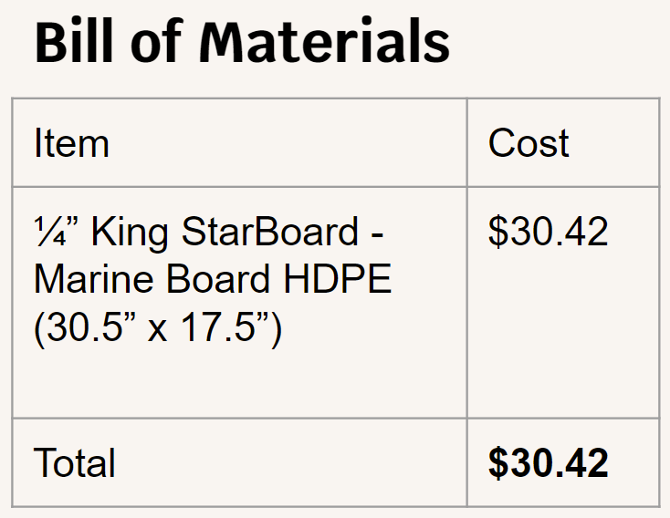
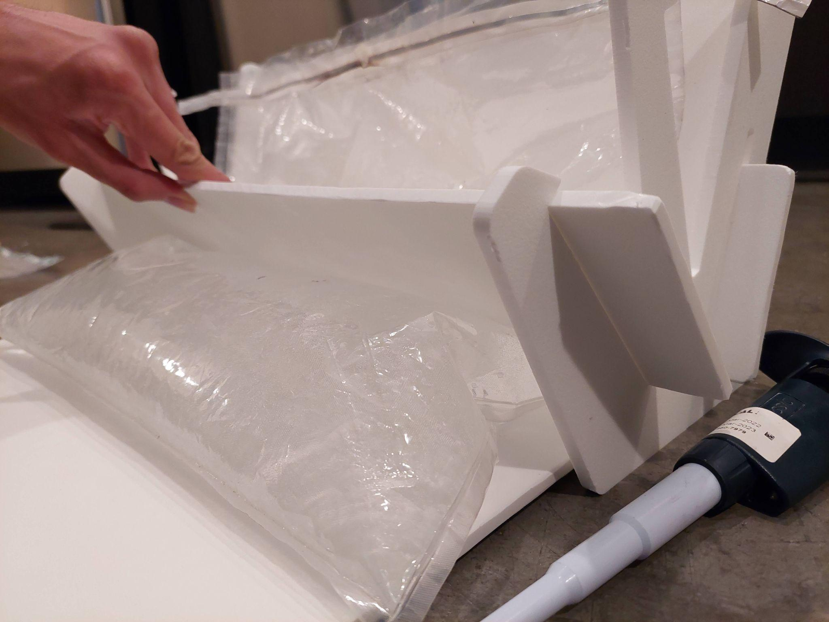



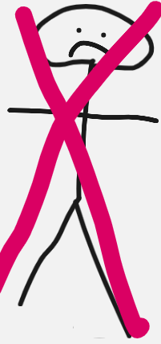
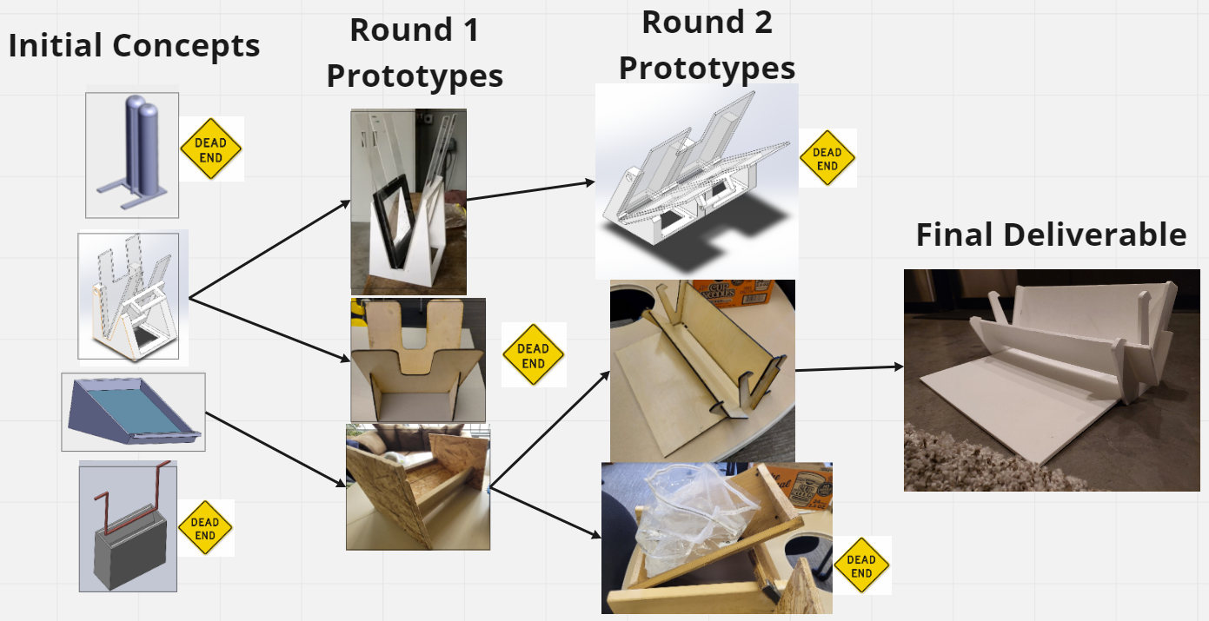
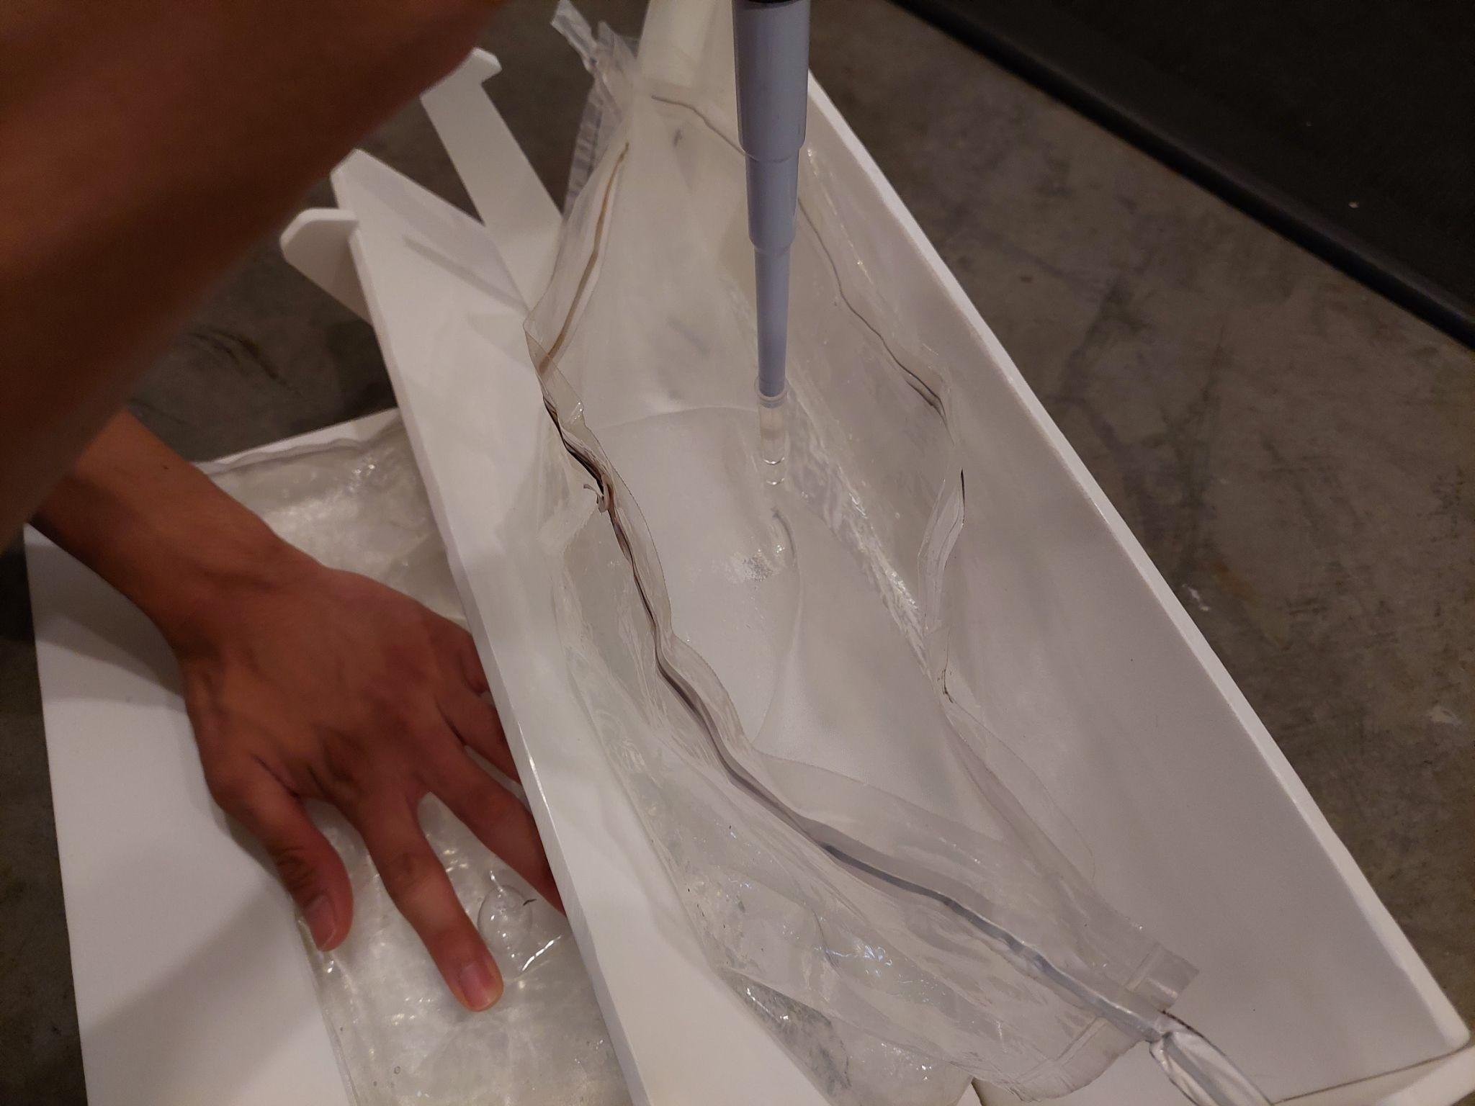
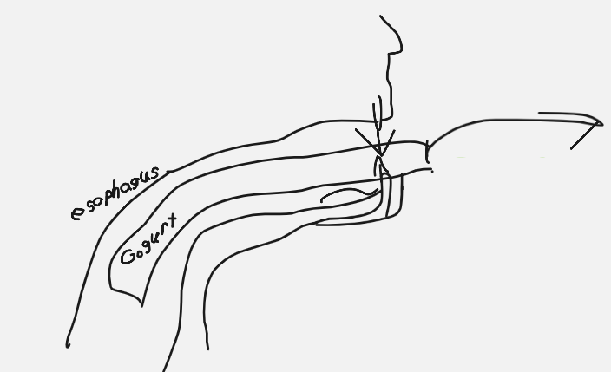
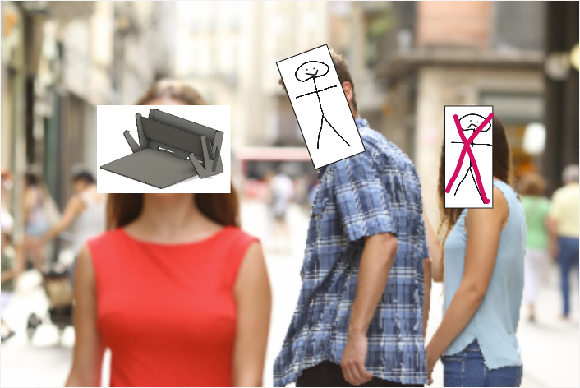
-xxxxxxx
Some Todos:
Iteration tree could be nicer (bigger pictures)
\
Parts of analysis
Conclusion
MilliporeSigma - Bag Handling Project
Team Millileaders: Ian Benedict, William Matney, Harrison Jerome, Grayson Wang
College of
Engineering
¹Departments of Industrial and Mechanical Engineering, University of Washington
Research Mentors: Patricia Buchanan, Jordan Kestel
Background
The Solution
Analysis
I was thinking FMEA might be too big/detailed to include on the poster
Current Sampling Process
Meets Customer Requirements
How it works
Time Savings
Time Studies Data:
*We consider a difference of ~3-4 seconds statistically insignificant for our purposes
Cost Savings:
Assuming an average salary of $80,000
and 30 minutes saved per 40 hour
workweek:
1.25% of 80000 = $1000 saved
annually, per worker
Process Step/Input | Potential Failure Mode | Potential Failure Effects | SEVERITY (1 - 5) | Potential Causes | OCCURRENCE (1 - 5) | Current Controls | DETECTION (1 - 5) | RPN | Action Recommended | Resp.
What is the process step or feature under investigation? | In what ways could the step or feature go wrong? | What is the impact on the customer if this failure is not prevented or corrected? |  | What causes the step or feature to go wrong? (how could it occur?) |  | What controls exist that either prevent or detect the failure? |  |  | What are the recommended actions for reducing the occurrence of the cause or improving detection? | Who is responsible for making sure the actions are completed?
Storage | Degradation, extra stresses on device | Unusable or unreliable device long-term | 3 | Incorrect storage conditions | 2 | Visual observation, standard storage conditions | 2 | 12 | Outline specific storage guidelines, review regularly | Millileaders team (creating guidelines), MPS leaders
Setup | Incorrect assembly, damaging parts during setup | Misuse/damage to device, lead to misuse | 3 | Inexperienced operator, damaged parts | 2 | Verbal/written directions for assembly; reinforcements at weak points | 2 | 12 | Make inspection a regular part of assembly each time the device is used | MPS leaders & technicians
Bag placement | Damage to device b/c of bag weight, misplacement | Spills, contamination damage/misuse of device | 2 | Inexperienced operator, damaged parts, unsual bag | 2 | Verbal/written directions for assembly; visual bag placement guidelines | 1 | 4 | Ensure technicians are experienced with handling bags | MPS leaders & technicians
Pressing bag/pipetting | Spill/contamination, strains on device when liquid is displaced | Spills, contamination, damage/misuse of device | 3 | Inexperienced operator, unusual bag and/or sample | 2 | Verbal/written directions for assembly; design limits active fluid displacement | 1 | 6 | Transparent polyarbonate faces facilitate visual detection of potential overflow | Millileaders team
MilliporeSigma develops cultures of bacteria in bags with different types of food. To measure bacterial growth, pipettes of the bag must me made. The current process is as follows:
Only requires 1 technician
Ergonomic operation
Resistant to cleaning agents
Avoids spills
Durable
Work for various bags/fluid volumes (1L to 3L)
Compact Storage
Lightweight
HDPE is inert and reusable
(Strength Analysis, not sure if people care)
Totals (seconds)
Phase: | Average | Std. Dev. | Median | Range
2-Person | 27.70 | 2.67 | 27.05 | 10.37
Wedge-Squeezer | 30.86 | 2.95 | 30.99 | 12.23
Differences: | 3.16* | 0.28 | 3.94* | 1.86
FEA/strength Type analysis will really round things off nicely
One technician uses two hands to hold the bag while the other technician holds a pipette.
The technician holding the bag squeezes the bag in order to raise the water level. At this point the second technician pipettes the fluid.
The technician dispenses the fluid into an assay tray for further testing. The bag is resealed and this whole process is completed for every bag.
A technician opens the device by removing the removable plate, and leans an open bag against the back plate.
IRL stuff:
Demo of 2 person process
Table with prototypes
Bags (w/ water ?)
Pipettor
What to wear
The Problem
Currently, two technicians must attend the sampling process.
How can we make the sampling process a one-person task?
Motivation:
Improve efficiency
Save time, save money
2. The technician reinserts the removable plate to secure the bag in place.
Initial Concepts -> round 1 prototypes -> round 2 prototypes -> final design, talking with technicians directly to get feedback to guide the design
Design Iterations
3. The technician uses one hand to push water up from the base of the bag, and uses the other hand to get a pipette sample.
Next Steps
-Manufacturability for large-scale production
-Further improve design ergonomics
-Create a more sustainable design
Acknowledgments
Jordan, MilliporeSigma Lab Technicians, Patty, MilliporeSigma, ME Machine Shop, The MILL, The 8, ISE/ME departments
Notes:
https://docs.google.com/document/d/10lex7MXeygFFnGIcWryZMfJLlAMBM187cTC9VPsFsAk/edit

Slide 2
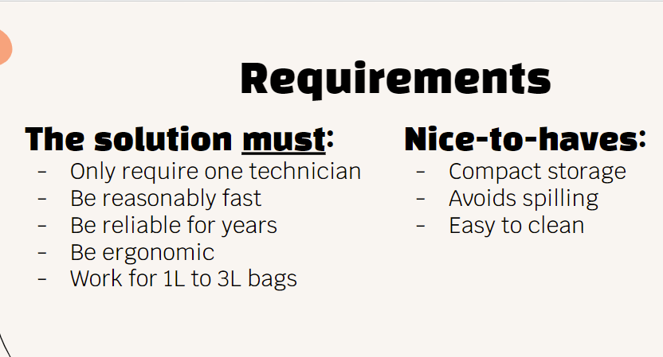
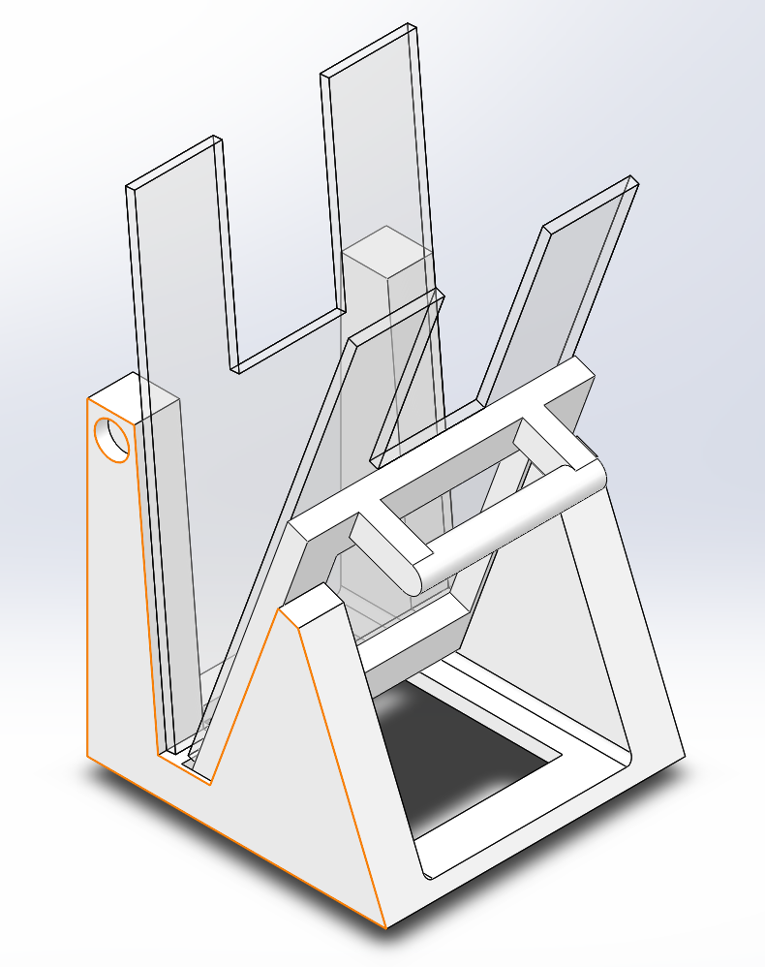
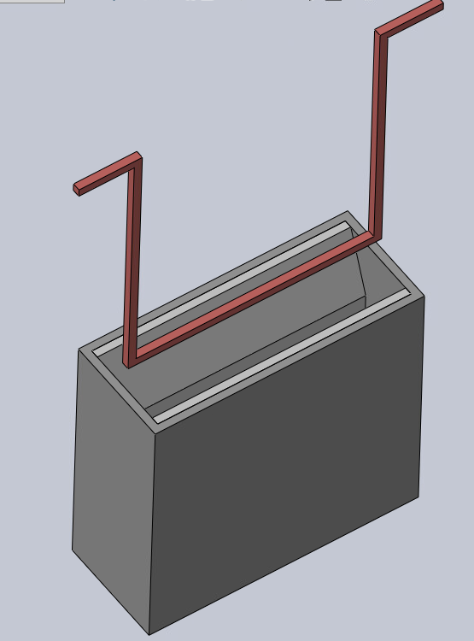
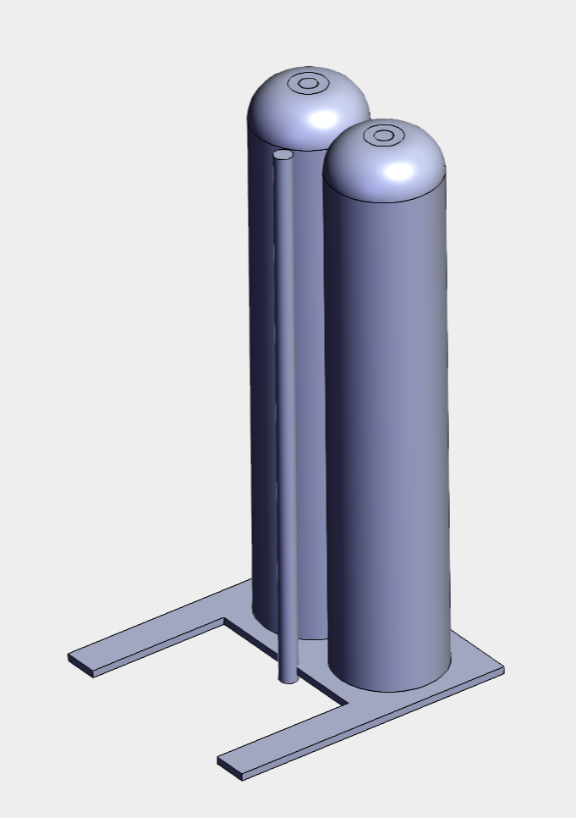
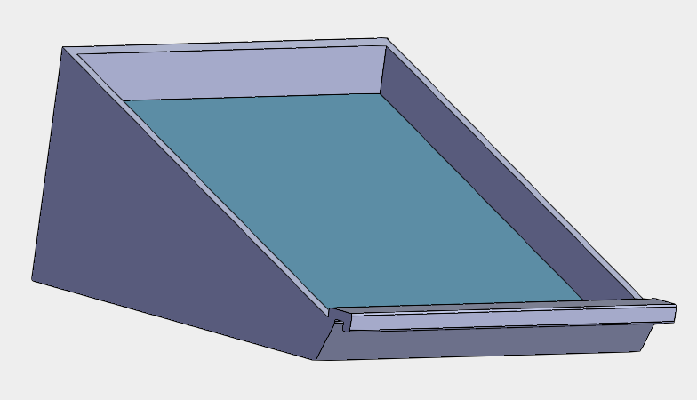
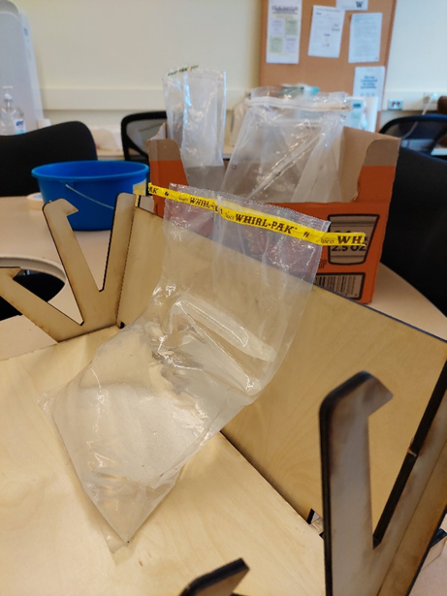
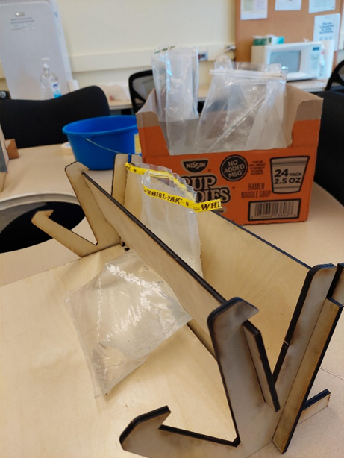
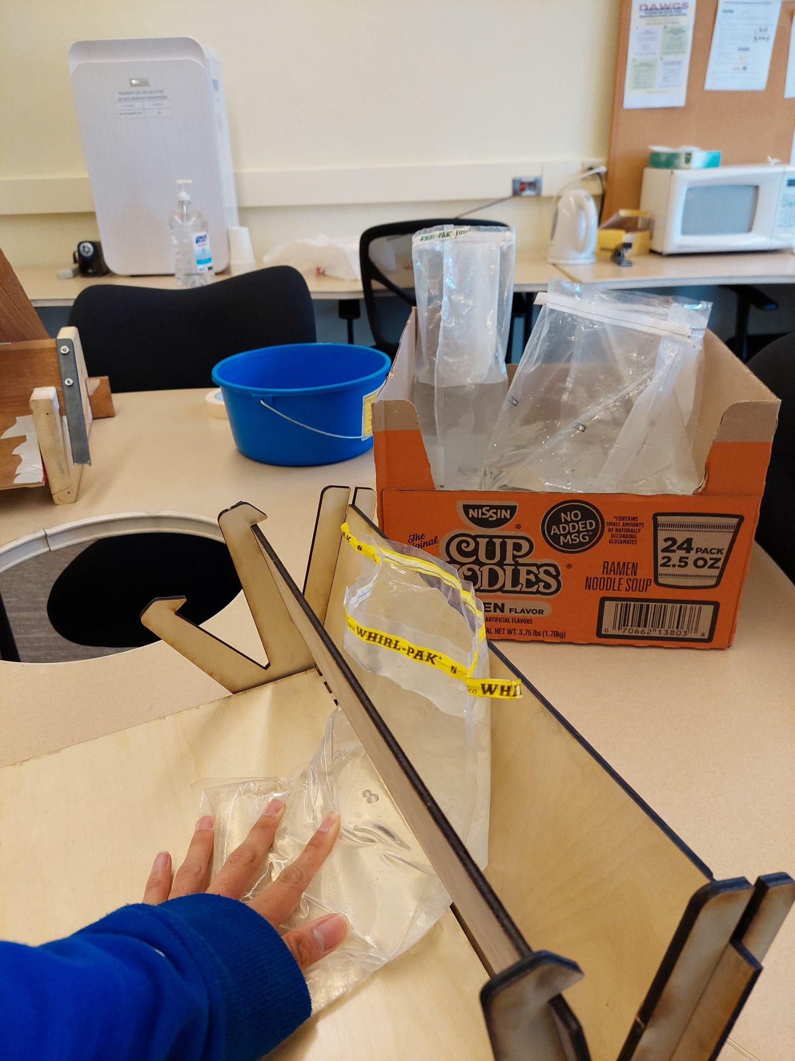
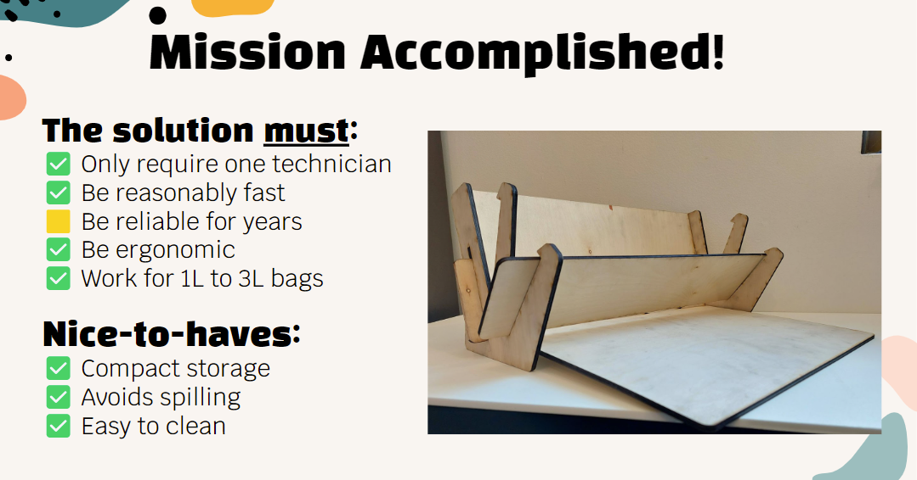
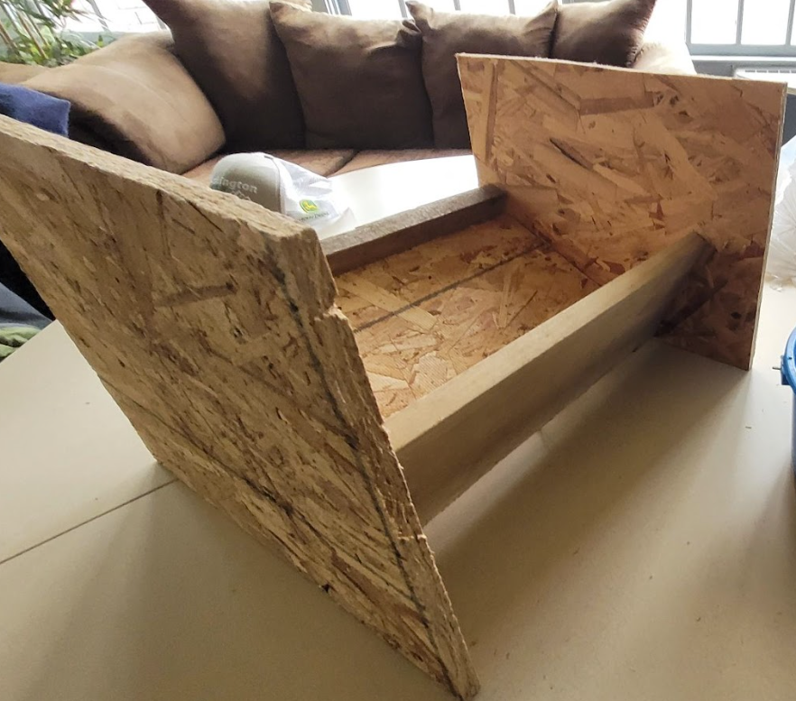
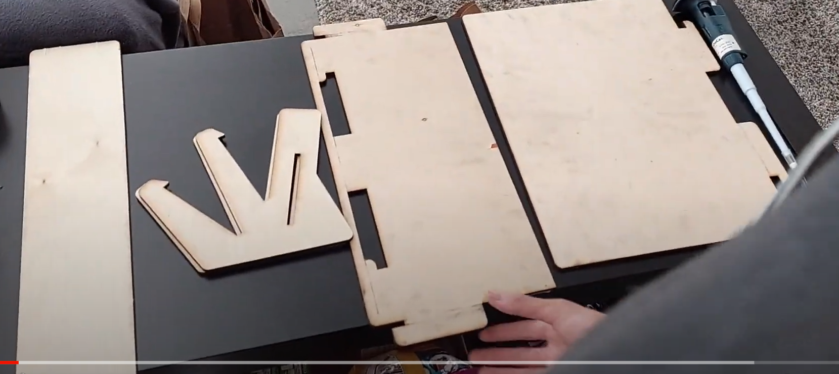
Old stuff but might be useful so it’s still here
MilliporeSigma - Bag Handling Project
Team Millileaders: Ian Benedict, William Matney, Harrison Jerome, Grayson Wang
College of
Engineering
¹Departments of Industrial and Mechanical Engineering, University of Washington
Research Mentors: Patricia Buchanan, Jordan Kestel
Introduction
Problem Statement & Goal
Analysis
Who is Millipore Sigma
*actually other posters looks like they don’t explain much about the company
Currently, two technicians must attend the sampling process.
How can we make the sampling process a one-person task?
 | Totals
 | Average | Std. Dev. | Median | Range
2-Person | 27.70 | 2.67 | 27.05 | 10.37
Wedge-Squeezer | 30.86 | 2.95 | 30.99 | 12.23
Time Savings, maybe some simple graphics
Process Step/Input | Potential Failure Mode | Potential Failure Effects | SEVERITY (1 - 5) | Potential Causes | OCCURRENCE (1 - 5) | Current Controls | DETECTION (1 - 5) | RPN | Action Recommended | Resp.
What is the process step or feature under investigation? | In what ways could the step or feature go wrong? | What is the impact on the customer if this failure is not prevented or corrected? |  | What causes the step or feature to go wrong? (how could it occur?) |  | What controls exist that either prevent or detect the failure? |  |  | What are the recommended actions for reducing the occurrence of the cause or improving detection? | Who is responsible for making sure the actions are completed?
Storage | Degradation, extra stresses on device | Unusable or unreliable device long-term | 3 | Incorrect storage conditions | 2 | Visual observation, standard storage conditions | 2 | 12 | Outline specific storage guidelines, review regularly | Millileaders team (creating guidelines), MPS leaders
Setup | Incorrect assembly, damaging parts during setup | Misuse/damage to device, lead to misuse | 3 | Inexperienced operator, damaged parts | 2 | Verbal/written directions for assembly; reinforcements at weak points | 2 | 12 | Make inspection a regular part of assembly each time the device is used | MPS leaders & technicians
Bag placement | Damage to device b/c of bag weight, misplacement | Spills, contamination damage/misuse of device | 2 | Inexperienced operator, damaged parts, unsual bag | 2 | Verbal/written directions for assembly; visual bag placement guidelines | 1 | 4 | Ensure technicians are experienced with handling bags | MPS leaders & technicians
Pressing bag/pipetting | Spill/contamination, strains on device when liquid is displaced | Spills, contamination, damage/misuse of device | 3 | Inexperienced operator, unusual bag and/or sample | 2 | Verbal/written directions for assembly; design limits active fluid displacement | 1 | 6 | Transparent polyarbonate faces facilitate visual detection of potential overflow | Millileaders team
Requirements
Old Process
FEA/strength Type analysis will really round things off nicely
Method: 3 Rounds of Prototype Iteration
One round of CAD:
The wedge
Round two of physical usability testing
One technician uses two hands to hold the bag while the other technician holds a pipette.
The technician holding the bag squeezes the bag in order to raise the water level. At this point the second technician pipettes the fluid.
The technician dispenses the fluid into an assay tray for further testing. The bag is resealed and this whole process is completed for every bag.
IRL stuff:
Demo of 2 person process
Table with prototypes
Bags (w/ water ?)
Pipettor
What to wear
New Process
Conclusions
Better pictures later
good
A technician opens the device by removing the removable plate, and leans an open bag against the back plate.
The technician reinserts the removable plate to secure the bag in place.
The technician uses one hand to push water up from the base of the bag, and uses the other hand to get a pipette sample.
References
Results
nice things:
Resistant to bleach, isopropylwhateveritwascalled
Simple disassembly enables compact storage and access to all surfaces for easy cleaning
Enables pipetting for full range of bag sizes and water volumes
Ergonomic operation
Lightweight (3.3 lb)
(Placeholder)
Exploded view to show how pieces assemble together
Acknowledgments
Jordan, Technicians, Patty, MilliporeSigma, ME Machine Shop, The MILL, The 8, ISE/ME departmentss
Notes:
https://docs.google.com/document/d/10lex7MXeygFFnGIcWryZMfJLlAMBM187cTC9VPsFsAk/edit

