Slide 1
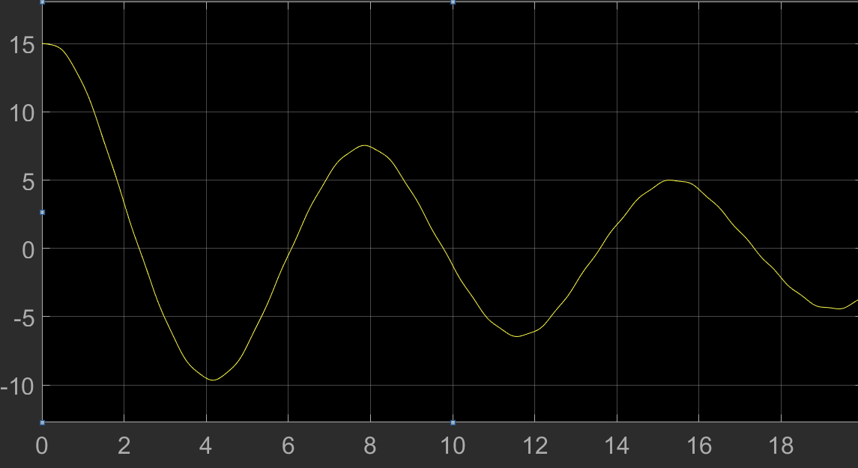
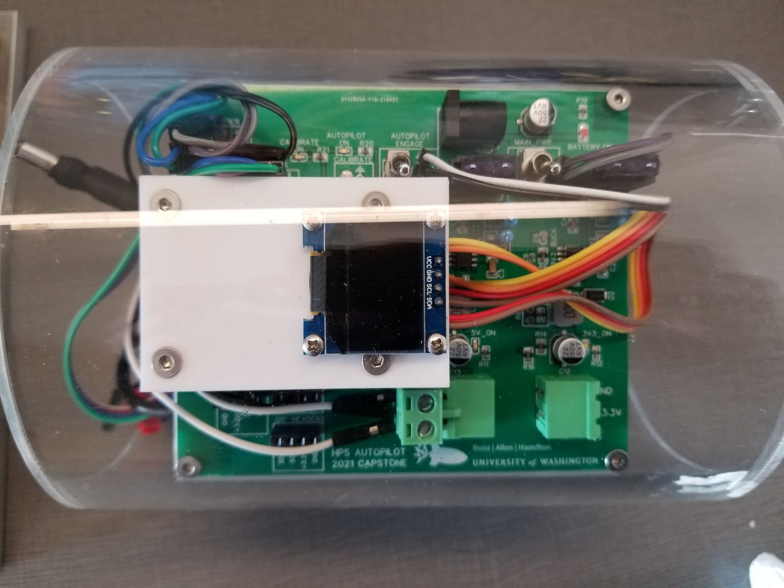
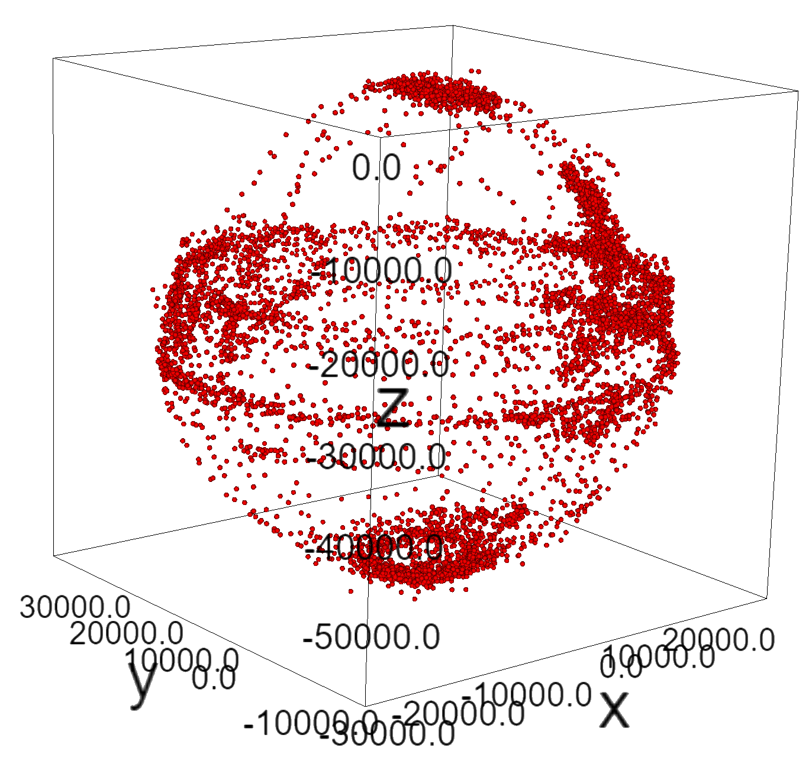
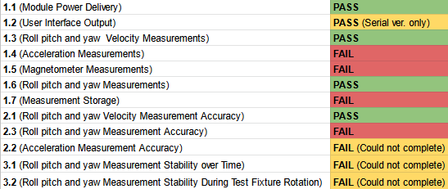
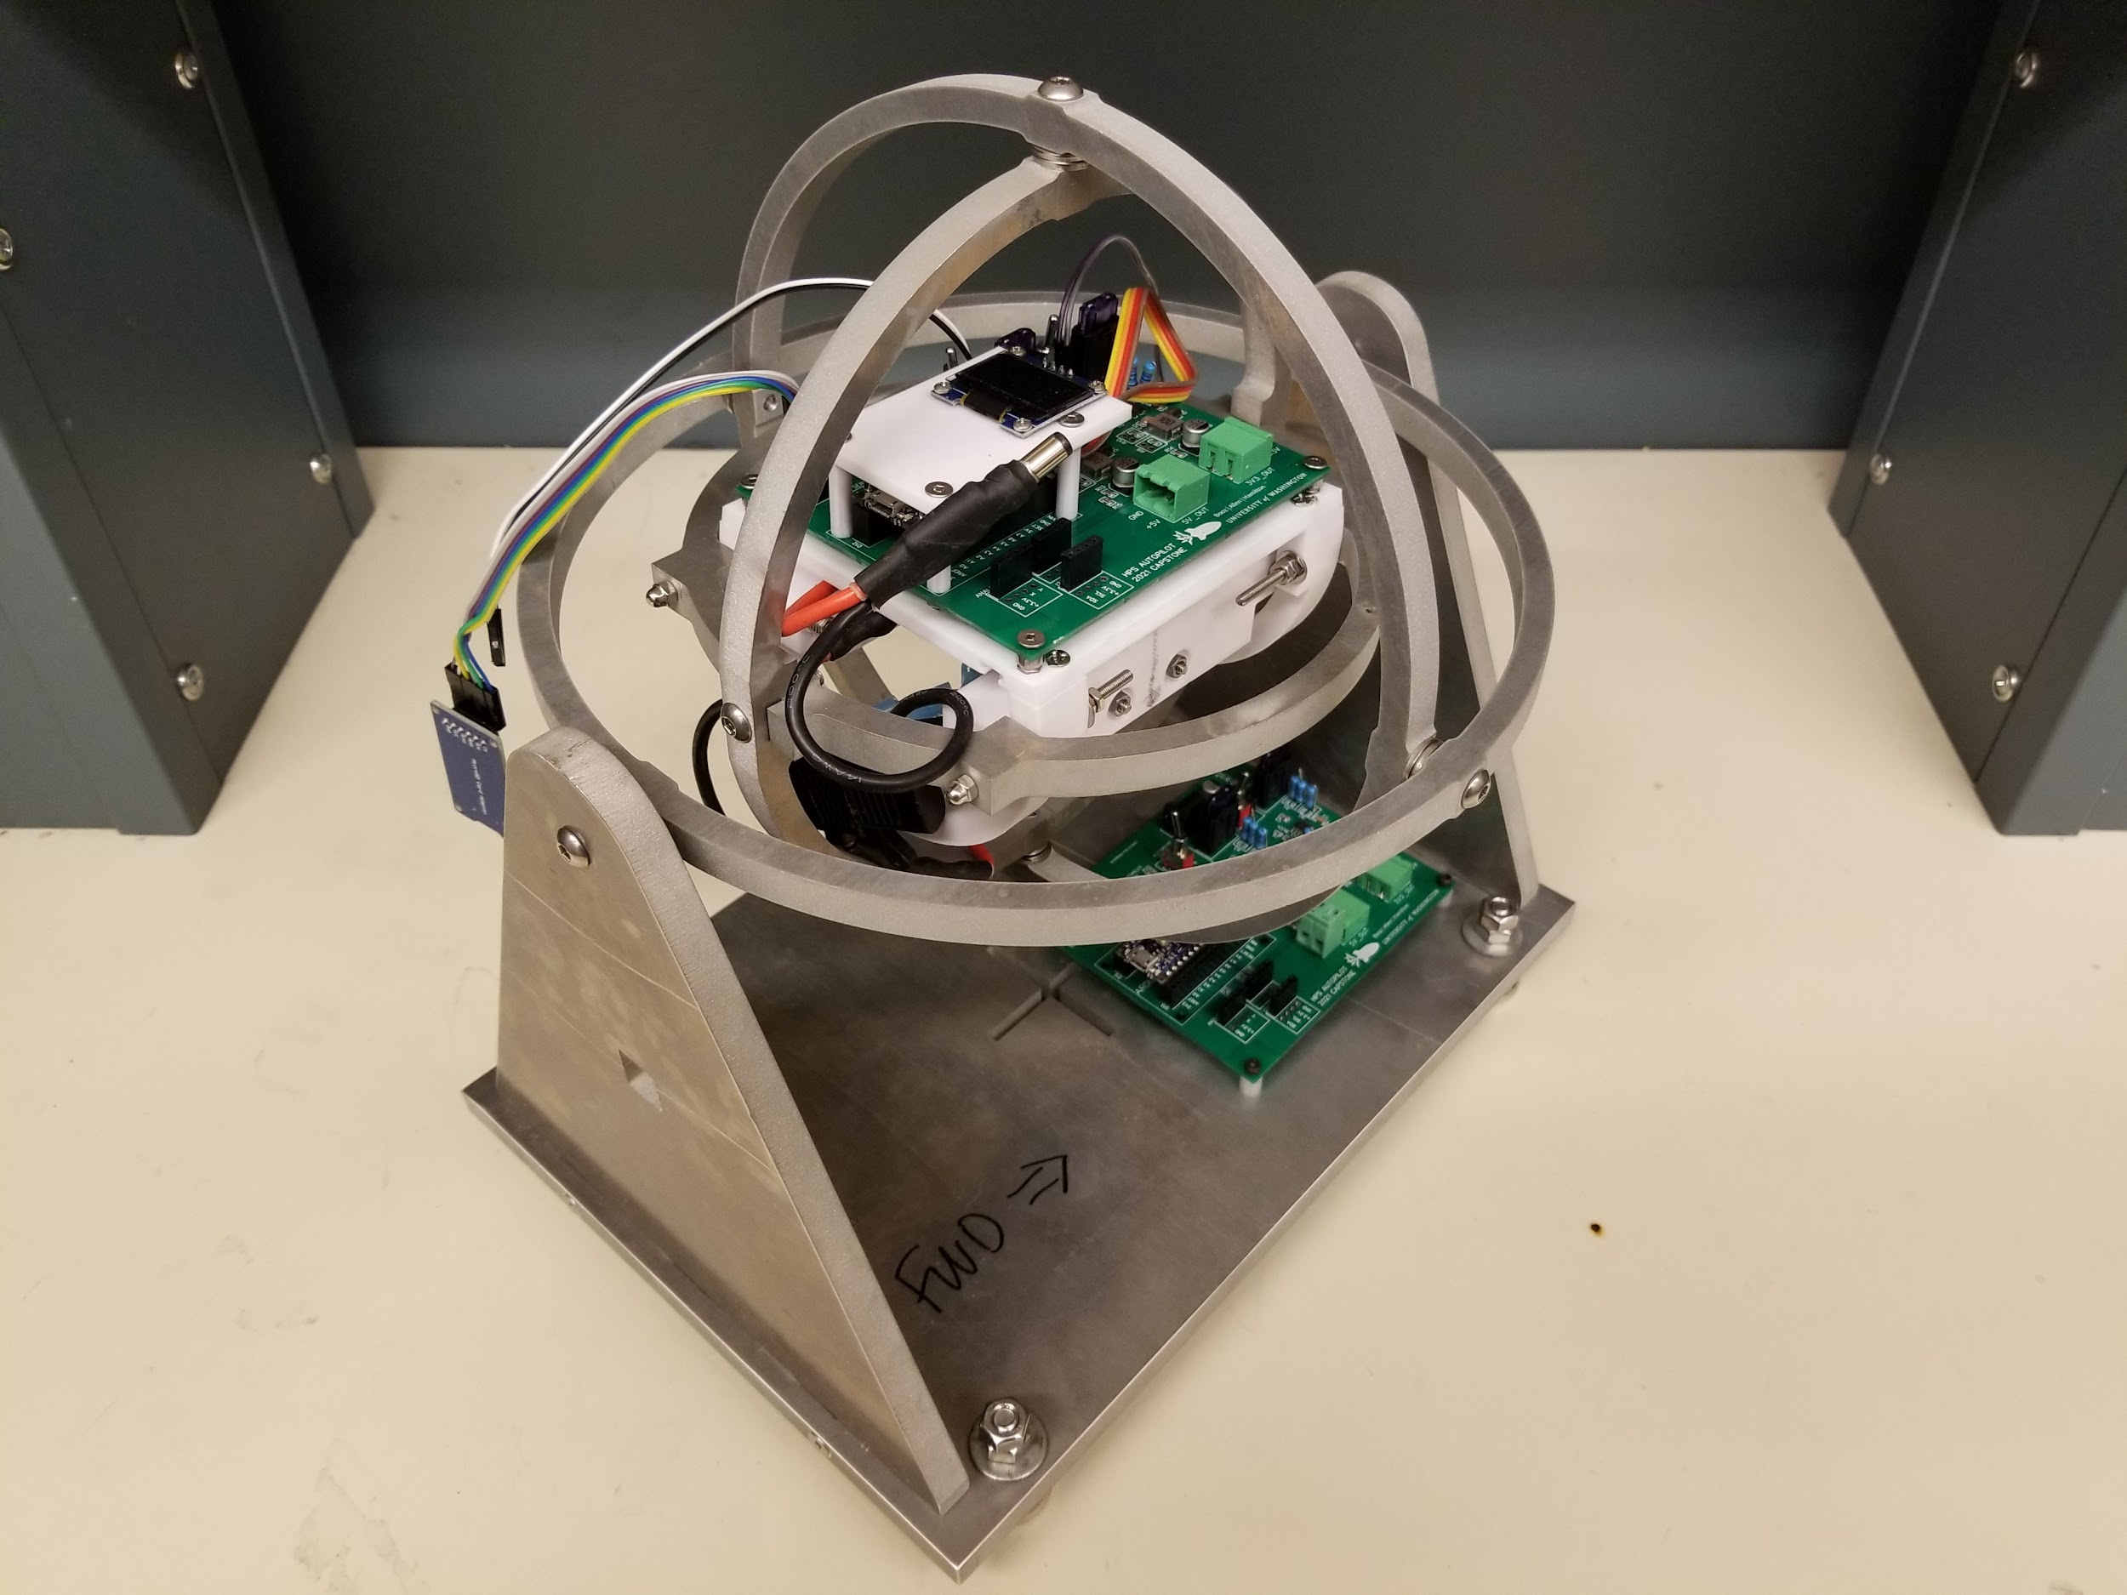
UW Human Powered Submarine
Autonomous Roll Control Validation
24
STUDENTS: David Maltby, Noah Parker, Nicole Pham
Overview
Controls Testing
Discussion and Future Work
The HPS Autopilot Capstone is an ongoing project to develop a roll control module that will:
Keep the submarine stable at high and low speeds
Improve the handling experience of the submarine
HARDWARE / SOFTWARE
Module is not ready for implementation in a submarine setting. Module cannot accurately measure yaw angles. Physical device is prone to pins breaking off in headers and the battery pack is cumbersome to remove.
Future teams will need to perform:
Partial redesign of PCB
Redesign of battery casing
CONTROLS
Controller does decrease roll error but struggles to reach steady state in under 20 seconds with normal use case body velocities (under about 2.5m/s). There is room for improvement in controller design.
Future teams may want to look into:
Simulink’s PID tuner
Linear quadratic regulator controls (LQR)
Further refining hydrodynamic equations
Automating force and moment calculations using Computational Fluid Dynamics (CFD)
Controls modeling was performed in MATLAB Simulink
Phase Three Requirements
Model simulated
Phase Two’s Controller’s:
PID settings
Fin actuation with fin limiters
Hydrodynamics
Hull lift and drag
Fin lift and drag
Rigid body dynamics
Added mass inertia
Hydrostatics
Weight
Buoyancy
Disturbances
Pilot pedaling
Sensor noise
Example model of submarine dynamics
Test design for implementation readiness
Investigate the hardware’s functionality, performance, and reliability
Evaluate the control design’s calculations and performance
Document suggestions for design revisions
Record test data and outcomes
Roll Angle (Degrees)
Time (s)
Hardware Test Results
Multiple options for AHRS redesign:
Correct magnetometer error
Fix magnetometer calibration procedure to obtain better raw data
Utilize specialized calibration software and integrate code libraries for the IMU (Internal Measurement Unit)
Use alternate methods to obtain yaw values
Position second module’s roll/pitch axis to line up with main module’s yaw axis and feed in data
Hardware Test Plan
Testing revealed significant error in yaw measurement
Magnetometer calibration was determined the most likely cause
Prototype Autopilot Module completed by previous year’s team
Two-board system to measure fixture rotation relative to a point
Three phase test plan:
Functionality: Does the device function at a baseline level
Performance: Does the device function according to specifications
Reliability: Does the device maintain accurate results under real-world conditions
Also required: methodology to translate rotation of gimbal to rotation of a reference point
Calculated using homogeneous transforms
Raw magnetometer data (units in nanoTesla)
Attitude and Heading Reference System:
Utilizes sensor fusion to estimate roll, pitch, and yaw
Three sensors need to each be tested in the IMU (Internal Measurement Unit):
Gyroscope
Accelerometer
Magnetometer
References and Acknowledgements
Scan for references
Faculty: Cassie Riel, Ben Maurer, Sam Burden
Industry: Dan Burke
Undergraduate: Cole Helms
ADVISORS: Eric Jones
INDUSTRY MENTORS: Nick Valladarez, Khoa Tran, Ryan Edwards, Joseph Reck, Ryck Thompson
SPONSORS: Booz Allen Hamilton

