Slide 1
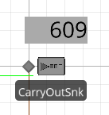
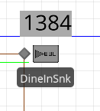
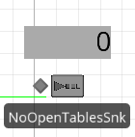
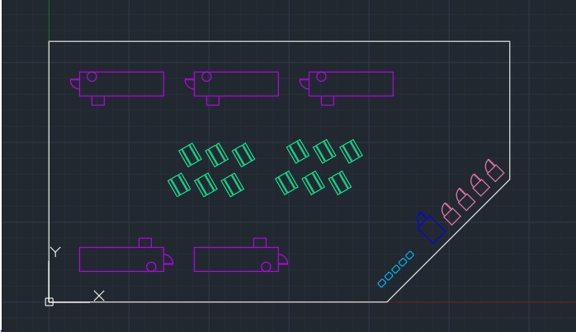
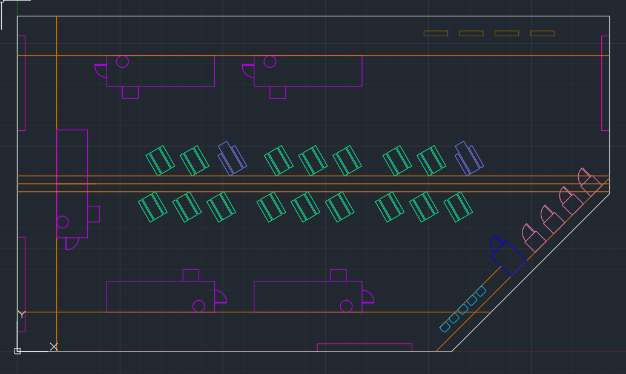
UW Electric Food Trucks
ISE: Ivan Iturriaga, Jacob Fink, Joanna Garcia,
Lapat Pattaraarayakul
ME: Bobby Pederson, Cole Burge, Matt Kim,
Nahom Ghirmay, Xiange Wang
Problem: Most food trucks use gas generators to cook their food, which produce excessive noise and fumes. Furthermore, trucks with electric capabilities do not have locations to charge while in operation.
“To design a food truck that shall run on renewable energy and utilize electric appliances as well as a plaza/bay that shall host and supply power to these food trucks.”
Research
Data Collection
Surveyed consumers for requirements of a food truck plaza
Spoke with food truck owners for information on their current operations
Existing Plazas
Looked at 24 different
food truck plazas.
Then find the average size and
Its corresponding number of
food trucks. Therefore we can
predict how much space Is
needed for 1-12 food trucks.
Simulation/Modeling
Created plaza designs using data collecting and information about existing plazas.
Plaza Designs
Project Statement
Amenities
Bay/ Curbside
4 food trucks
2 Charging Stations
No seating
The bay/ curbside design can be made with variable number of food trucks depending on available space.
Simple
5 food trucks
4 Porta-Potties
108 numbers of seats with tables
Our Simple Plaza design dimensions are based on a location at 1518 1st Avenue, Seattle. There are multiple entrances and exits for food trucks which allows for easy rotation. There are 18 seating area with tables with each area allowing up to 6 people.
Amphitheatre
Stairs: 6” riser x 13” tread
Within regulation
Long tread slows the speed of walking
Handrail: 34” above stairs, extends 1’ beyond edge of stairs
Within regulation
Steps (for seating): 18” riser x 48” tread
Ergonomic sitting
Enhanced viewing angles from any distance
Apart from food trucks in the plaza, there must be amenities such as tables, benches, waste disposal and restrooms as well. From the survey results and data on other existing food truck plazas, we obtained the following information:
Seating
Survey result:
30% of people “carried-out” vs. 70% “dined-in”. This is verified using Simio to show that the minimum number of tables have no balking.
Restrooms
Survey result:
There is little interest in whether there are
restrooms or not
and also little interest in whether it is Porta-potties or built-in restrooms.
However, there is a need for public handwashing stations.
Waste Disposal
We gathered wastes from food truck such as spoon, forks and containers and weigh then to calculate the averages produced per person. (1 paper wrapper weighing 2 grams, 1 fork, etc.). Then using equations and foot traffic data to get a total amount of waste per day. After that we then also start evaluating against different variety and sized bins with pick-up frequency. The assumptions are validated using Simio model. There will also be dumpsters for food truck owners and custodians emptying plaza bins periodically.
Smoothie
Exclusively serves frozen treats and has a medium power draw Panini
Basic sandwich truck, with a low power draw BAFT
Burger and Fry Truck
All out model, with 20 ft cab and biggest set of appliances
Solution Methodology
Survey Summary
Amenities | Percentage
Tables | 40%
Benches | 33%
Don't Care | 47%
Covered Seating | 27%
Porta-potties | 27%
Don't Care | 40%
Looked at existing Electric Food Trucks
Looked at existing Plazas
3.0
Generates solar power
1.0
Provides Parking Space
2.0
Provides Charging Station
OR
4.0
Generates biodiesel power
AND
6.0
Receive Food Trucks
7.0
Manage Waste Disposal
8.0
Provide Customer Seating
5.0
Generates electric power
9.0
Provide Accessible Entrance and Exit
1.1
Prep Parking Space
2.1
Prep Charging Station
7.1
Prep Disposal Site
Trucks
Acknowledgements: Patricia Buchanan, Joyce Cooper, Seattle City Light, Washington Food Truck Association

